Slide 1
Educational Leisure Program for Special Needs
BME 401 A: Senior Capstone Design
Group 18: Carlie Abraham, Tong Yu, Yanlin Ho

Slide 2
Table of Contents
Background
Need
Scope
Design Alternatives
Device
Platform
Storage
Symbol Systems
Budget

Slide 3
Background
Alicia James
Southview School
Age: 5-21 years old
Developmental disabilities
Motor disabilities

Slide 4
Need
Age-appropriate leisure activities
Keeps students attentions
Can be done alone or with guardian/parent/teacher
Wide range of accessibility functions

Slide 5
Scope
We will create a web-based program targeted at older special needs students with the purpose of improving their social and practical life skills and providing leisure activities that can be done alone, with quick navigation and accessibility functions for users with motor disabilities and reading challenges.

Slide 6
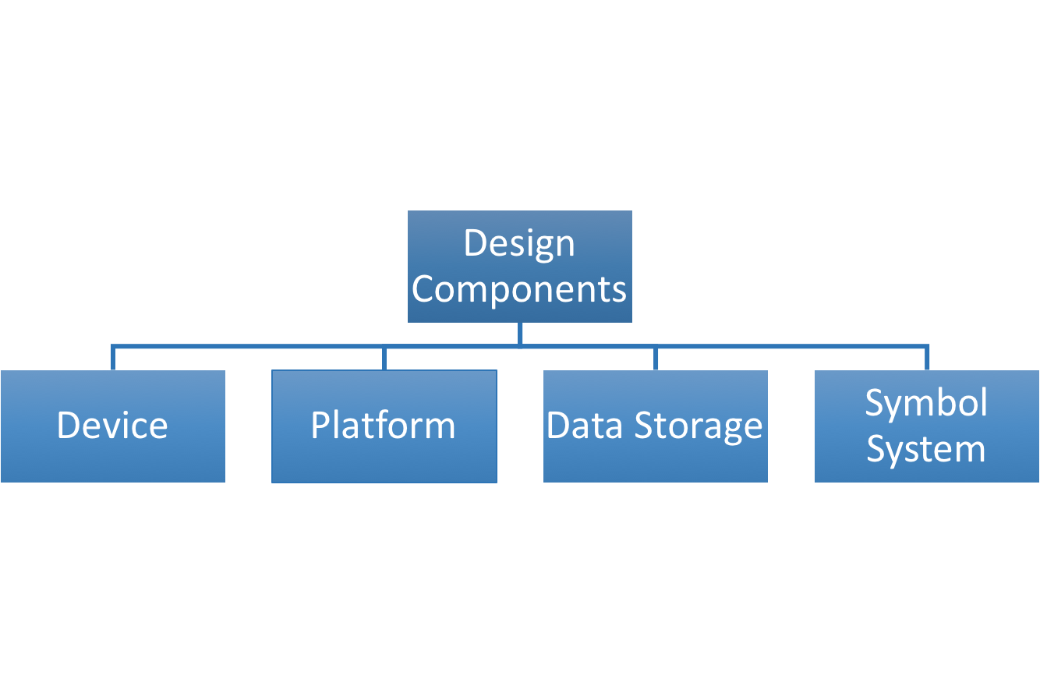

Slide 7
Device Solution
Laptop/Computer:
Pros: high RAM, abundant storage, very available to client, large screen size, good connectability (USB port, HDMI port, etc.)
Cons: high price, low resolution, short battery life
Tablet
Pros: low price, high resolution, long battery life
Cons: low RAM, low storage, low connectability
Mobile Device
Pros: long battery life, low price
Cons: low RAM, low storage, low connectability, small screen size, low availability

Slide 8
Device Solution, Pugh Chart Analysis

Slide 9
Platform Solution - AWS with LAMP
AWS: Amazon Web Services: Virtual Cloud Computing
EC2 instance: Virtual computing environment
Tools for Website Server/Design
Flexible code
AWS-backed security
Administrative control

Slide 10
Platform Solution - AWS/Wordpress
Has many same features as AWS/LAMP such as security, cost
Access to templates, website building tools
Needs external plugins to expand functionality
Sacrifice control over website for ease of use

Slide 11
Platform Solution Bluehost/Wordpress
Hosting platform with DNS included
Wordpress already installed
Less flexibility, customization options
Security: Sitelock
$33/year for hosting, DNS

Slide 12
Platform Solution, Pugh Chart Analysis

Slide 13
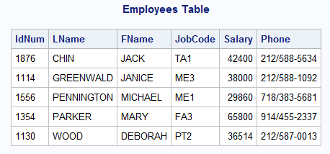
Data Storage Solution - SQLite/MySQL
Relational database (keys have associated tributes, stored in table form)
Data tables stored in a database
Data types strictly defined
Good interoperability
Database
Table 1
Table 2
Table 3

Slide 14
Data Storage Solution - MariaDB
A spin off of SQL
Relational database similar to SQL
Data types strictly defined with exception of dynamic columns
Faster query speed than SQL

Slide 15
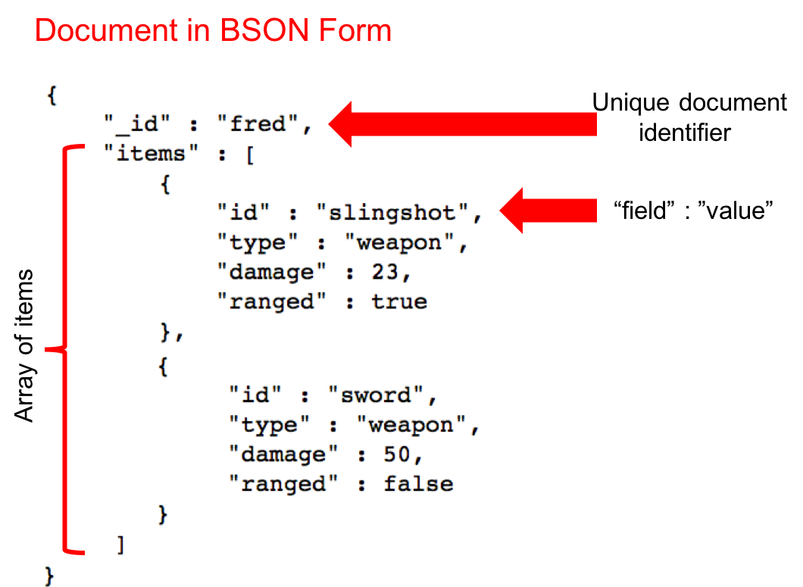
Data Storage Solution - MongoDB
Non-relational database
Data stored in “Documents,” which make up “Collections”
Same data types available as in SQL, with the addition of arrays
Documents provide flexibility in data storage patterns
Faster query speed than SQL

Slide 16
Data Storage Solution, Pugh Chart Analysis

Slide 17
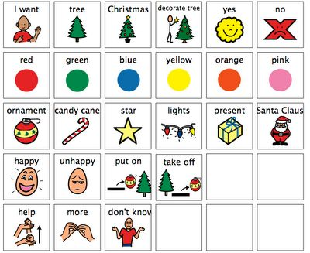
Symbol System Solution - PCS
Large symbol bank: over 12,000 symbols
Already used by client
Represents mainly concrete concepts
Cartoonish style

Slide 18
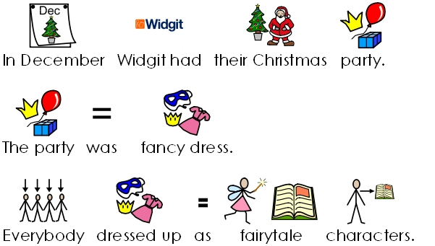
Symbol System Solution - Widgit
Includes both concrete and abstract concepts
Used in some activities in the school
Cartoonish style

Slide 19
Symbol System Solution - Sclera
Developed by Belgian program
Uniquely designed for students with visual impairment
Two-colour scheme
Limited symbols available

Slide 20
Symbol System Solution - Pugh Chart Analysis

Slide 21
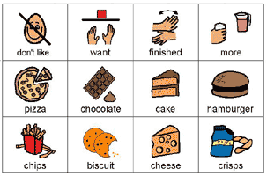
PCS

Slide 22
Budget
Server hosting costs: $50/year
Domain name hosting costs: $25/year
Total Budget: $75

