Slide 1
Interactive Program for Special Needs Children Group 18
Team: Carlie Abraham, Yanlin Ho, Tong Yu
Client: Alicia James

Slide 2
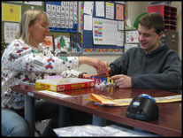
Background
Client: Alicia James
Speech language pathologist
Southview School
5-21 year olds
Developmental Disabilities
Figure 1

Slide 3
Background
Figure 2
Developmental Disability
Autism Spectrum Disorder
Cerebral Palsy
Down syndrome
1 in 6 children had a developmental disability from 2006-2008 in the US
Down syndrome: 1 out every 700 babies in US

Slide 4
Exact Need
Issue: Class activities and supplementary content only geared towards elementary school students, lack social aspect
Need: Activities for older special needs kids with wide range of accessibility functions, for both individual, multiplayer, and in-class use

Slide 5
Project Scope
Create a web-based platform combining educational and leisure materials targeted at older special needs students with the purpose of improving cognitive and motor skills, that can be done individually or in groups
Include compatibility for accessibility functions for users with motor disabilities, visual impairments, and reading challenges

Slide 6
Design Specifications
Primary platform: Web-­based
Accessibility Functions:
Standards-Compliant Colors
Inverted color scheme
Buttons with symbols
Switch control accessibility
Text-to-speech functionality

Slide 7
Design Specifications
Teacher/student accounts
Varying difficulty levels
Classroom/individual settings
Pairing on multiple devices
Budget: $200 (Hosting/Consultant Fees)

Slide 8
Existing Solutions: Website
Help Kidz Learn
Games, stories, and songs to develop speaking, listening, and reading skills
Examples: Talking Parrot Game, Little Duck Song
Currently used by client
Advantage: cognitive skill
Disadvantage: target age
Figure 3

Slide 9
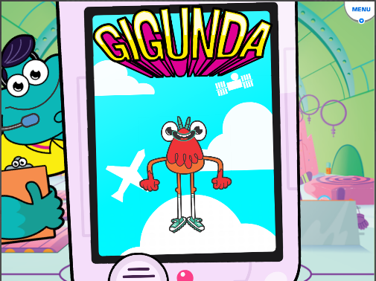
Existing Solutions: Website
GoNoodle
Collection of videos and games
Aimed to get kids moving and exercising
Categories: guided dancing, stretching, calming, and coordination
Currently used by client
Advantage: motor skill
Disadvantage: target age
Figure 4

Slide 10
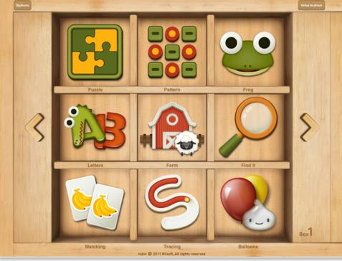
Existing Solutions: Apps
Injini
Educational games for toddlers and preschoolers with developmental delays
Aims to improve memory, language skill, motor skill, and auditory processing
Disadvantage: target age, lacks social aspect
Figure 5

Slide 11
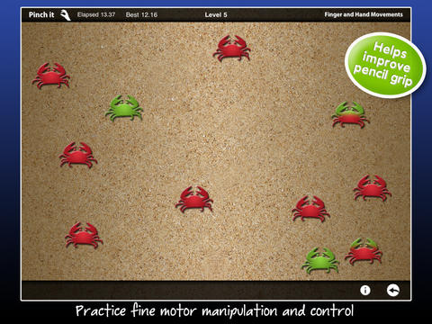
Existing Solutions: Apps
Other Apps
Predictable
Communication aid
Text-based
Disadvantage: not for leisure
Dexteria
For improving fine motor-skills
Disadvantage: too specific
Math Evolve
For learning challenges
Disadvantage: too specific
Figure 6

Slide 12
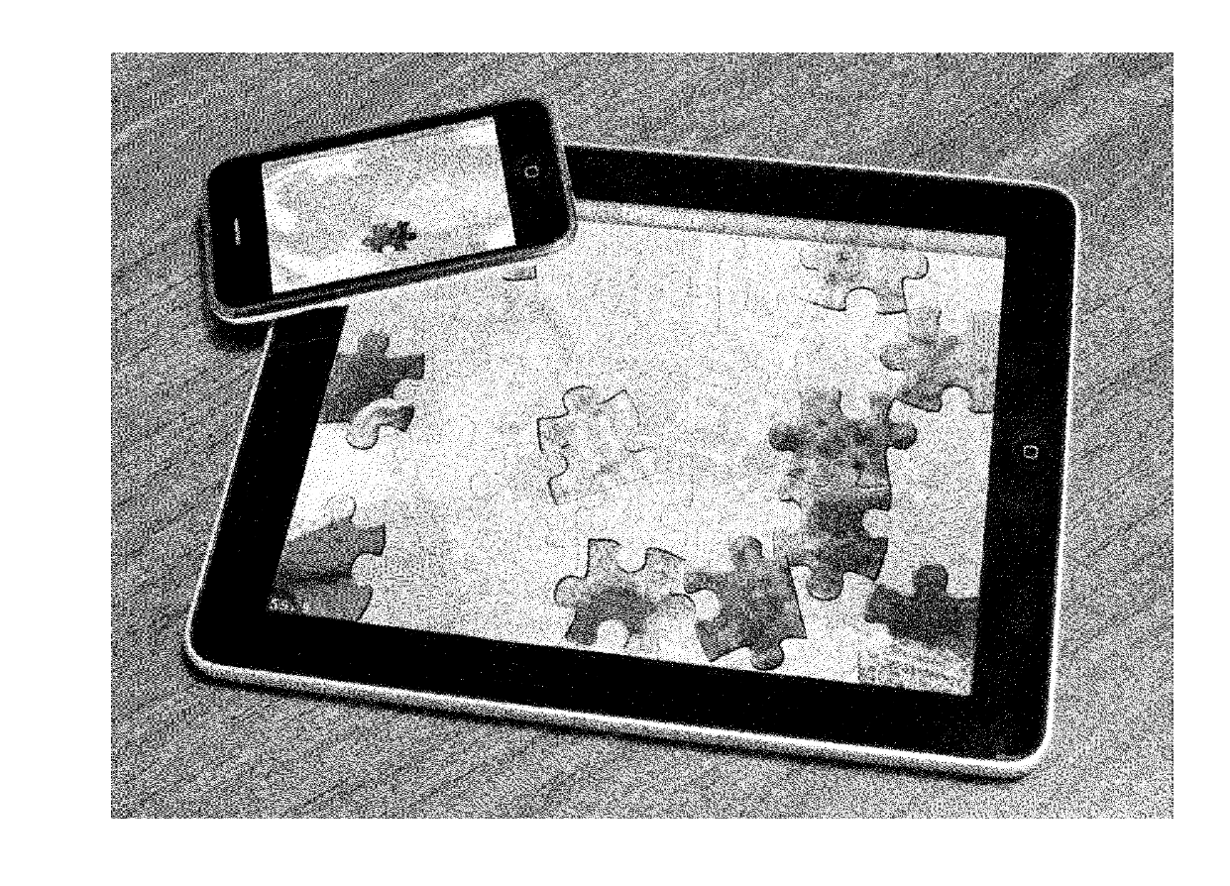
Existing Solutions: Patents
Mobile Jigsaw Puzzle Game
Patent: US20130079079 A1
Physics simulation
Puzzle pieces slide down when screen is tilted
Can be used to improve information processing and coordination
Disadvantage: motor skill range, lacks social aspect
Figure 7

Slide 13
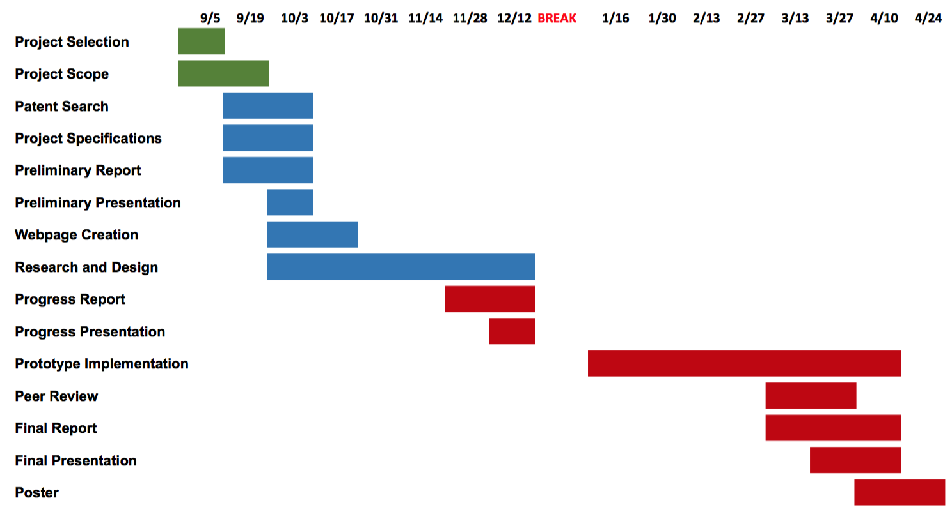
Design Schedule

Slide 14
Team Responsibilities
Carlie
Organizer of group
Software development
Yanlin
Prototype testing
Manage finances and marketing
Tong
Communication with client
User interface design

Slide 15
Questions?

Slide 16
Sources
Figure 1: Retrieved from http://www.ssdmo.org/schools/about-us-5
Figure 2: Retrieved from http://www.cdc.gov/ncbddd/birthdefects/stories/downsyndrome.html
Figure 3: Retrieved from http://www.helpkidzlearn.com/apps/counting-songs-1
Figure 4: Retrieved from https://www.gonoodle.com/
Figure 5: Retrieved from https://itunes.apple.com/us/app/injini-child-development-game/id452962000?mt=8
Figure 6: Retrieved from https://itunes.apple.com/us/app/dexteria-fine-motor-skill/id420464455?mt=8
Figure 7: Retrieved from https://www.google.com/patents/US20130079079
[1] “Developmental Disabilities.” Center for Disease Control and Prevention. CDC. Web. October 11th. https://www.cdc.gov/ncbddd/developmentaldisabilities/facts.html
[2] “Autism Spectrum Disorder.” National Institute of Mental Health. NIH. Web. October 11th. https://www.nimh.nih.gov/health/topics/autism-spectrum-disorders-asd/index.shtml?utm_source=rss_readersutm_medium=rssutm_campaign=rss_full
[3] “Autism Facts.” Center for Disease Control and Prevention. CDC. Web. October 11th. https://www.cdc.gov/ncbddd/autism/facts.html
[4] “Cerebral Palsy Facts.” Center for Disease Control and Prevention. CDC. Web. October 11th. https://www.cdc.gov/ncbddd/cp/facts.html
[5] “Down Syndrome.” Center for Disease Control and Prevention. CDC. Web. October 11th. http://www.cdc.gov/ncbddd/birthdefects/downsyndrome.html
[6] “Southview School.” Southview School. Web. October 11th. http://www.ssdmo.org/schools/
[7] “Help Kidz Learn.” Help Kidz Learn. Web. October 11th. http://www.helpkidzlearn.com/
[8] “GoNoodle.” GoNoodle. Web. October 11th. https://www.gonoodle.com/
[9] “Injini.” iTunes. Web. October 11th. https://itunes.apple.com/us/app/injini-child-development-game/id452962000?mt=8
[10] “Dexteria.” iTunes. Web. October 11th. https://itunes.apple.com/us/app/dexteria-vpp-fine-motor-skill/id528144366?mt=8
[11] “Math Evolve.” Math Evolve. Web. October 11th. http://mathevolve.com/
[12] “Digital jigsaw puzzle game for mobile device platforms US 20130079079 A1”. Google Patents. Web. October 8, 2016. https://www.google.com/patents/US20130079079.
[13] “Data and Statistics.” Center for Disease Control and Prevention. CDC. Web. October 6th. <http://www.cdc.gov/ncbddd/autism/data.html>.
[14] “Key Findings.” Center for Disease Control and Prevention. CDC. Web. October 6th. https://www.cdc.gov/ncbddd/developmentaldisabilities/features/birthdefectsddkeyfindings.html

