Slide 1
CognoDojo
Carlie Abraham, Yanlin Ho, Tong Yu

Slide 2
Overview
Introduction/Scope
Project Overview
Prototype Demonstration
Validation and Verification
Future Directions

Slide 3
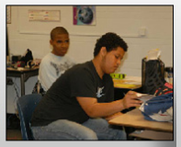
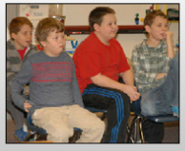
Background
Alicia James
Southview School
Students ages 13-21 years old
Developmental Disabilities

Slide 4
Need
Web-based program for leisure activities
Easy navigation
Age appropriate content matter
Customizable by the teacher

Slide 5
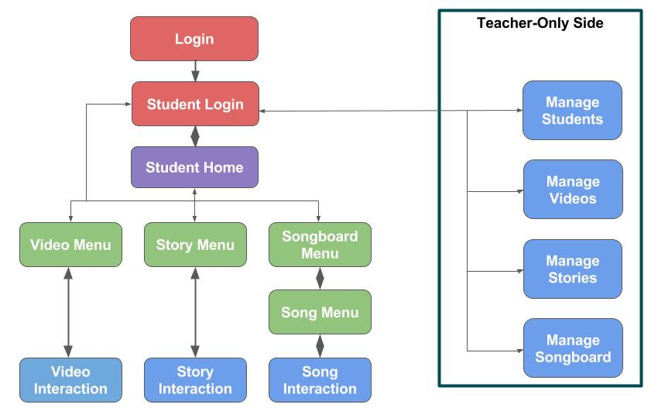
Website Overview
CognoDojo
Teacher & student accounts
Songs, videos, stories
Intuitive navigation

Slide 6
Website Setup
Amazon EC2 - Amazon AMI operating system
Mongo DB
Node.JS / Non-blocking IO
HTML, Javascript, CSS

Slide 7
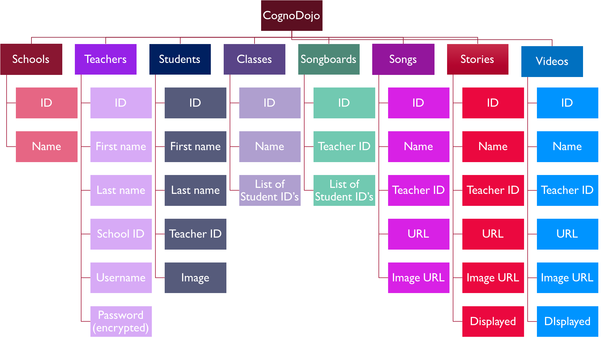
Website Setup
Amazon EC2 - Amazon AMI operating system
Mongo DB
Node.JS / Non-blocking IO
HTML, Javascript, CSS

Slide 8
Website Setup
Node JS Server on Amazon EC2
Amazon EC2 - Amazon AMI operating system
Mongo DB
Node.JS / Non-blocking IO
HTML, Javascript, CSS
User
User
User

Slide 9
Website Setup
Amazon EC2 - Amazon AMI operating system
Mongo DB
Node.JS / Non-blocking IO
HTML, Javascript, CSS

Slide 10
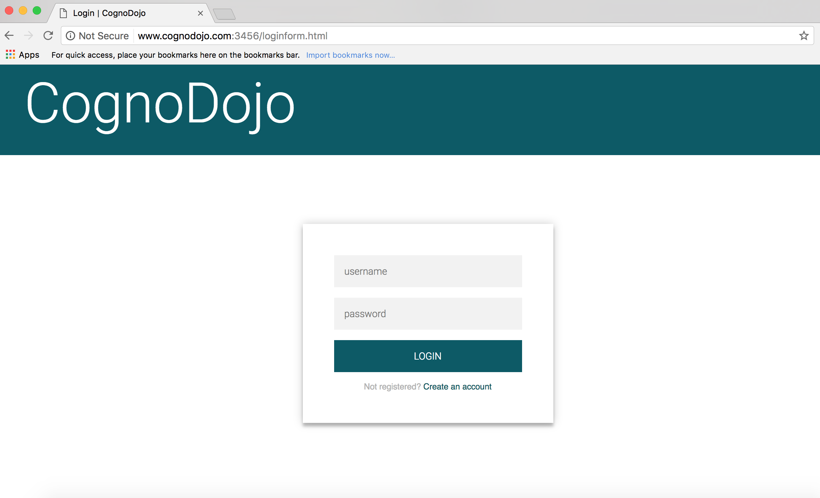
Website Demo
http://www.cognodojo.com:3456/loginform.html

Slide 11
Design Specifications
Availability
Design Specification | Requirements
Availability to the Client | Web browser, screen size compatibility.
Display | Size of display elements > 100px, 15px separation between elements, Font > 30px
Ease of use | Minimize navigation time, latency less than 1.5 seconds, intuitive flow
Accessibility | Color blindness accessibility, color contrast > 3:1
Security | Protect student and teacher information
Customizability | Customization of website by teachers
Display
Ease of Use
Accessibility
Security
Customizability

Slide 12
Verification and Validation
Availability
Survey for teachers
Average: 4+ out of 5 on all questions
Asked about: size of elements, ease of use, font and image choices, etc.
Tests with children
Special needs students
6 year old girl
Category | Avg. Score
General Impressions | 4.22
Student Homepage | 4.48
Activity Menus | 4.54
Interaction Pages | 4.45
Teacher Pages | 4.83
Display
Ease of Use
Accessibility
Security
Security
Customizability
Notes:
Survey Testing: size of display elements, usability
Student Testing: In classroom devices, ease of use

Slide 13
Verification and Validation
Availability
Latency
Time of content to load on each page
Achieved < 0.5 seconds
Navigation Time
Count number of clicks
No more than 5 clicks to any page
Display
Ease of Use
Accessibility
Security
Security
Customizability
Notes:
Latency: <1 sec
Number of clicks: <4 for all students
Minimise time required for teachers and students to reach activities and navigate website

Slide 14
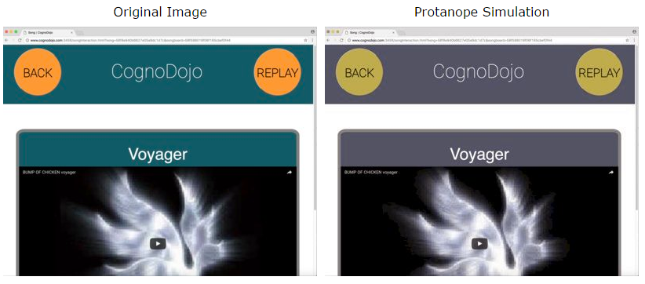
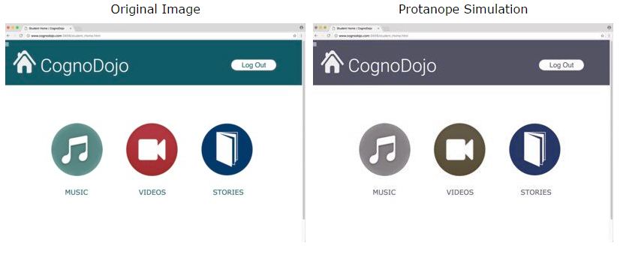
Verification and Validation
Availability
Color Blindness Accessibility
Color filter tests
Protanopia (red-blind), Deuteranopia (green-blind), and Tritanopia (blue-blind)
Display
Ease of Use
Accessibility
Security
Customizability

Slide 15
Verification and Validation
Availability
Color Contrast
WCAG Guidelines:
AA requires 4.5:1 for small text, 3:1 for large text
AAA requires 7:1 for small text, 4.5:1 for large text
Display Element | Colors | Color Contrast
Header |  | 7.86:1
Songs |  | 4.02:1
Videos |  | 6.63:1
Stories |  | 11.81:1
Return & Back Buttons |  | 9.86:1
Display
Ease of Use
Accessibility
Security
Customizability

Slide 16
Verification and Validation
Availability
Availability
Security
Prevent third parties from accessing student information
Passwords are encrypted
Customizability
All content chosen and controlled by teachers
Display
Display
Accessibility Functions
Ease of Use
Customizability
Accessibility
Security
Security
Customizability

Slide 17
Future Directions
More categories of activities
Incorporate different data formats
Symbol system
Text to speech options
Group activities by classes
Timed Activity Builders

Slide 18
Conclusion
Coding experience
Website development: Server-side, database, domains
Project Management
Thank You: Professor Klaesner and TA Darshit Mehta

Slide 19
Questions?

